Slide 1
Cyclistic: Member vs Casual Riders Bike Usage
By: Jaryot Ramirez

Slide 2
Presentation Outline
Objective
Findings
Recommendations
Questions

Slide 3
Objective
To analyze how riding patterns are different between Annual and Casual and identify the best marketing factors that would convert Casual riders to Annual members.

Slide 4
Findings
Percentage of total trips made by Member vs Casual riders
Which weekday is favored by Member vs Casual riders
Top 20 Trips made by Members and Casual riders
Which type of ride is preferred by Member and Casual riders
Length of rider prefered by Member and Casual riders
Less than one hour
Less than 2 hours

Slide 5
Data Source Used
Monthly Data pulled directly from Cyclistics under license with Motivate International Inc.
Data range consists from April of 2021 to March of 2022
Data was cleaned and documentation of cleaning process is documented in my github SQL repository for this project.

Slide 6
Percentage of Total Trips
Key understanding:
Members make up most of total rides

Slide 7
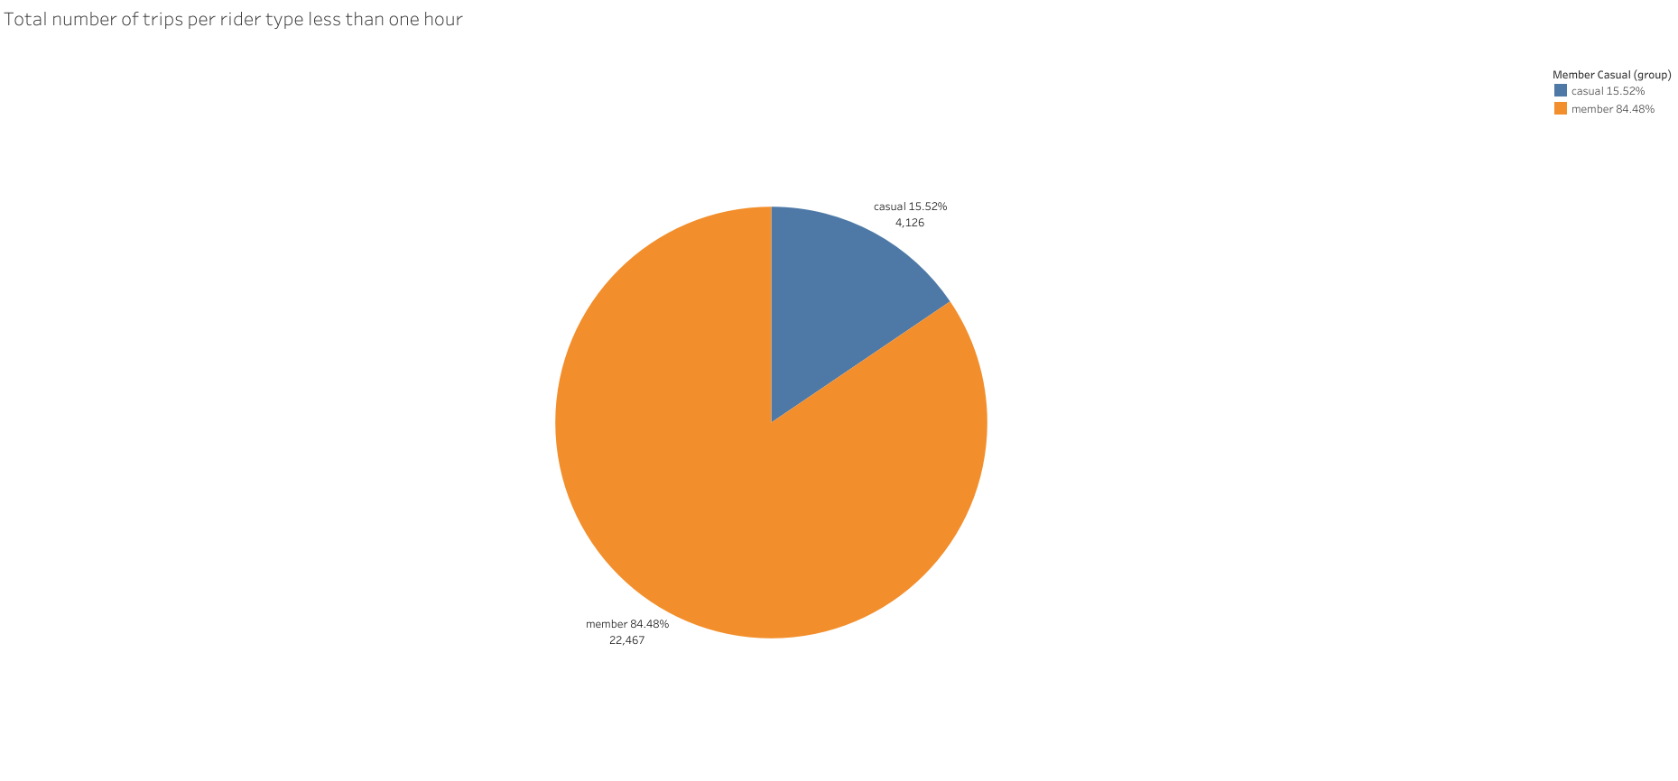
Number of Total Trips April 2021 to March 2022
Key Understanding:
Members make up a very large portion of total rides

Slide 8
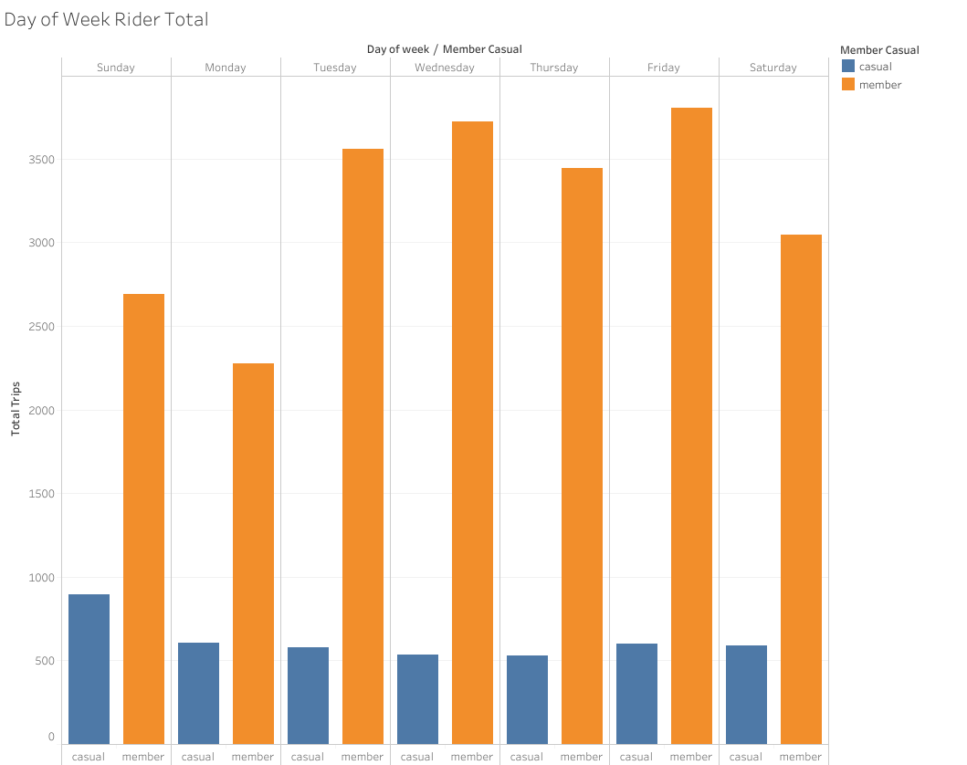
Number of trips made per Weekday
Key Understanding:
Members tend to make more trips during the work week
Casual riders tend to make more trips during the weekend

Slide 9
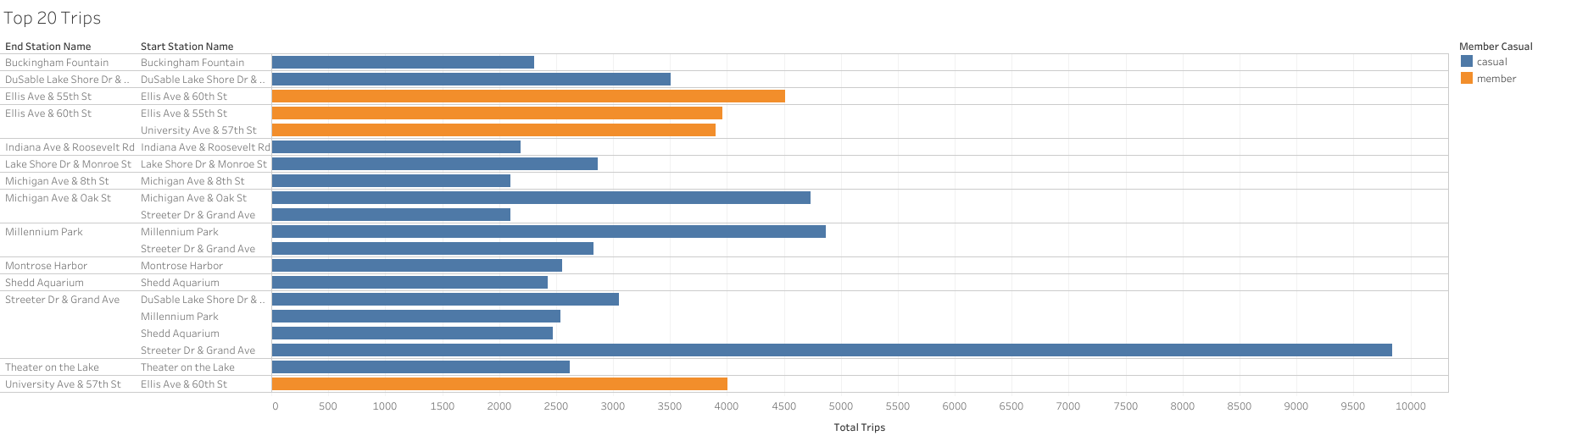
Top 20 Trips
Key Understandings:
Members tend to make more trips, but a wider variety.
Casual riders tend to make the same trips

Slide 10
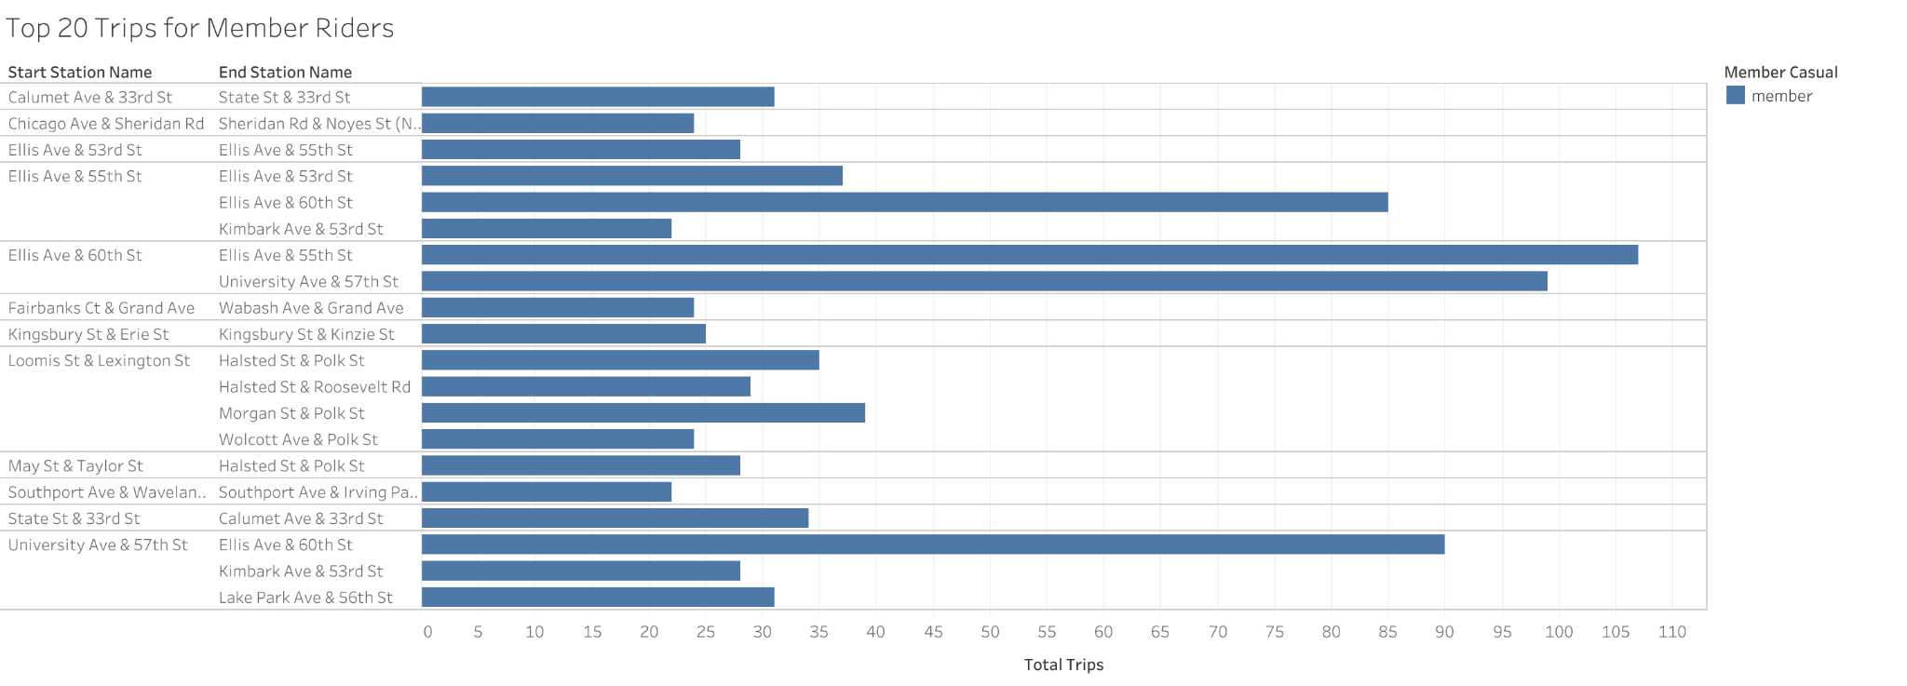
Top 20 Trips for Members
Key Understanding:
Members have a variety of trips prefered

Slide 11
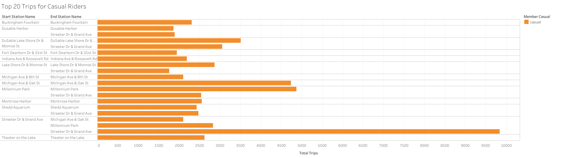
Top 20 Trips for Casual
Key Understanding:
Casual Riders tend to make the same popular trips

Slide 12
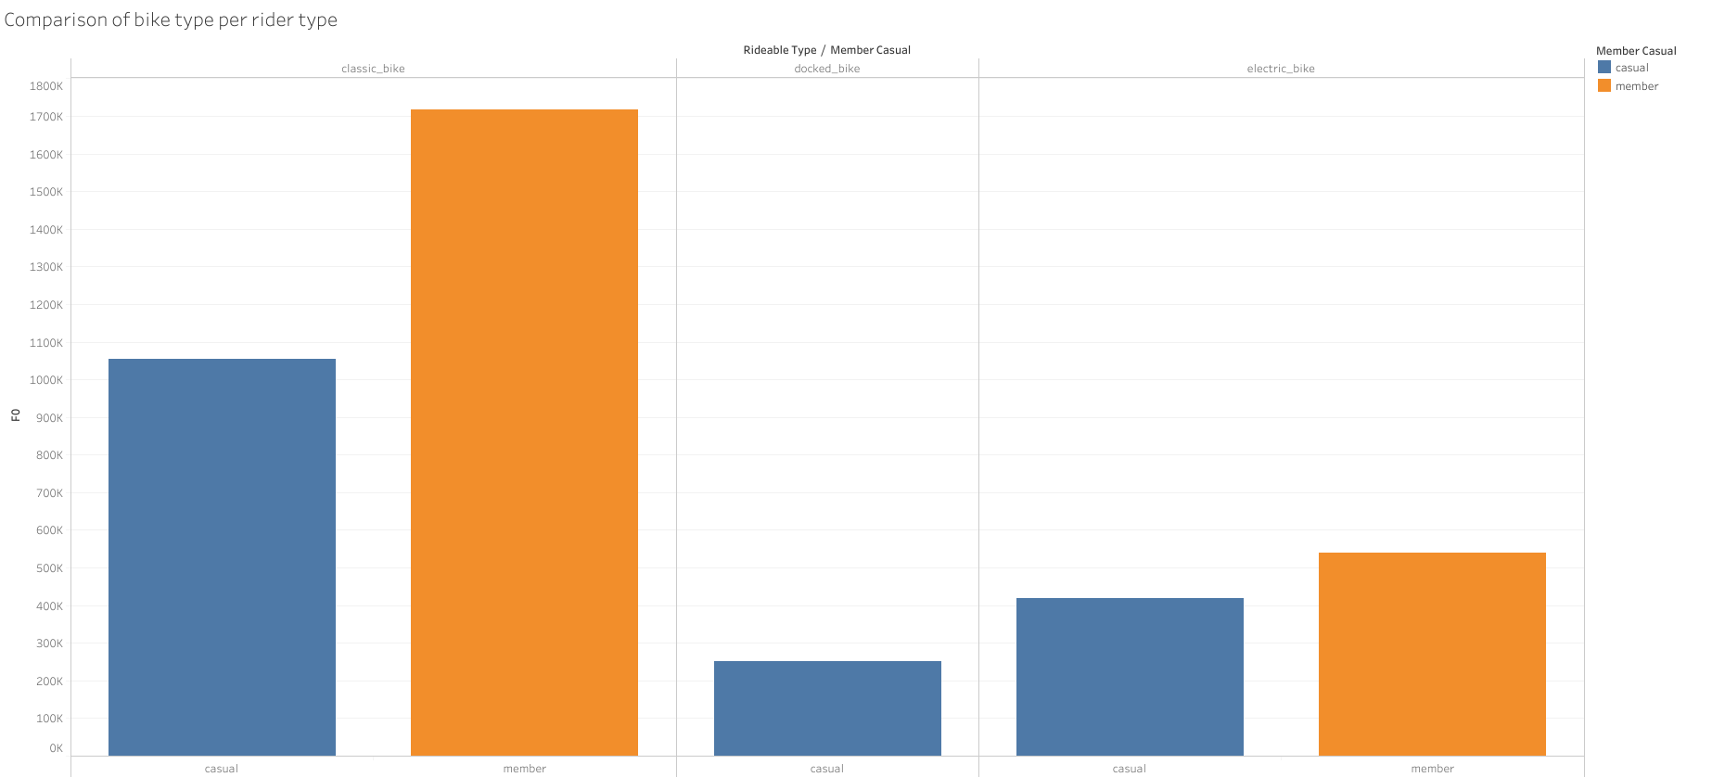
Type of Ride preferred for Member and Casual
Key Understanding:
Members and Casual riders much prefer classic bikes compared to other bikes
Docked bikes are the least favorite ride type with no members taking those rides and very little casual riders

Slide 13
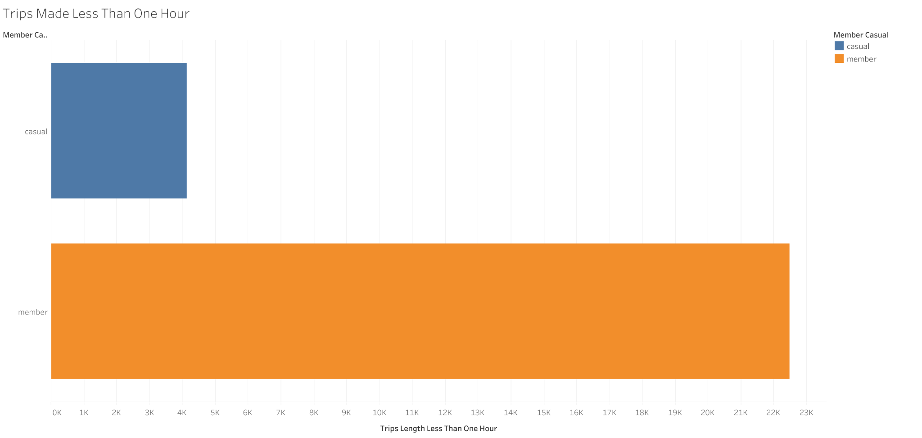
Length of Ride for Member and Casual: Less than 1 Hour
Key Understanding:
Members make up most of any trip under an hour

Slide 14
Length of Ride for Member and Casual: Less than 2 Hours
Key Understanding:
Most rides less than two hours are Member riders

Slide 15
Recommendations
Casual riders focus on few popular rides
Streeter and Grand Ave rides are by far the most popular rides and should be focused on in marketing efforts
Millenium Park & Michigan Ave are runner ups for popular ride destinations as well
Most casual riders tend to make trips under two hours.
Analysis was done for any rides over 24 hours and only 8 casual riders undertook these rides. May be worth advertising long trip discounts.
Casual riders tend to ride the most on weekends. While members tend to focus daily work week commuting.
Should be focused on in campaigns
Both member and casual riders tend to prefer classic bikes

Slide 16
Final Notes
Anomalies within the data:
No members within the data were shown to opt for the docked bike option
Inconsistent location id inputs
Repeating ride IDs
Data is heavily influenced by COVID-19 and many in 2021 doing remote work
NULL values in Start/End station names

Slide 17
Thank You for Listening!
Questions?

